Slide 1
MATH 304 - Numerical Analysis and Optimization
Project ---Least Squares Regression
Xi Chen
xc166
https://www.youtube.com/watch?v=yB8AHtW25WQ&ab_channel=espeson

Slide 2
Outline
Introduction
Methodology
Result
Discussion

Slide 3
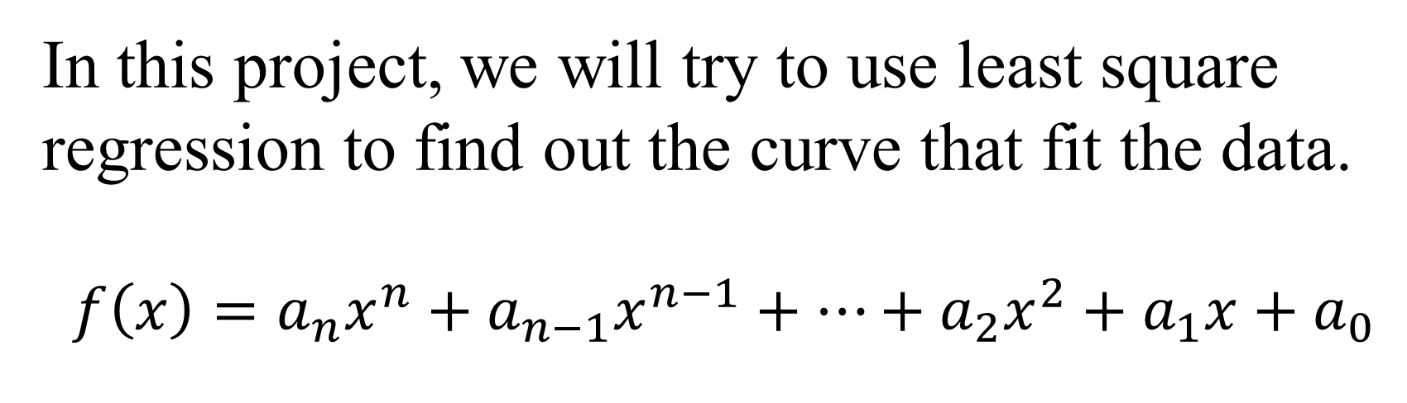
Introduction
In this project, we will try to use least square regression to find out the curve that fit the data.
$$f\left(x\right)=a_{n}x^{n}+a_{n−1}x^{n−1}+⋯+a_{2}x^{2}+a_{1}x+a_{0}$$

Slide 4
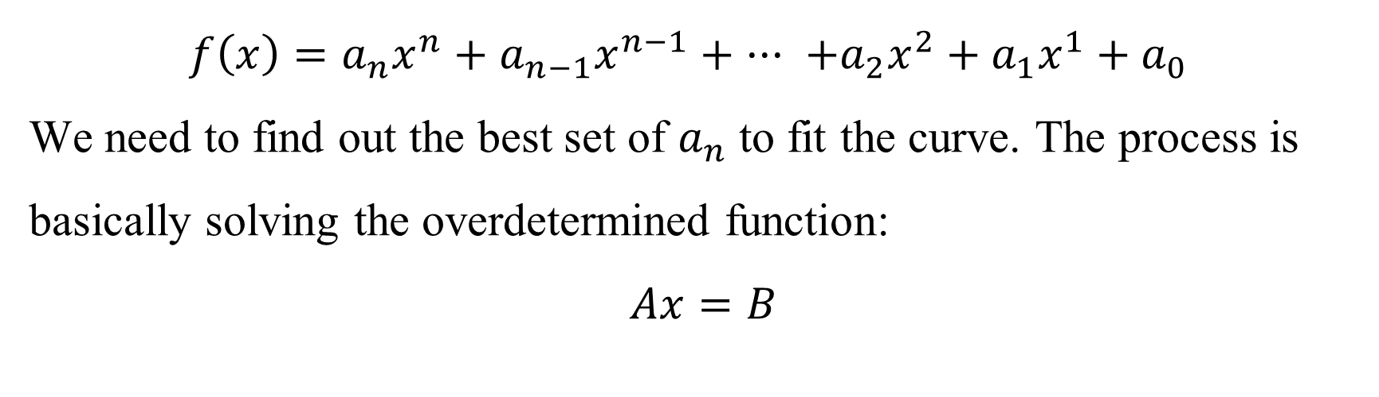
Methodology
$$f\left(x\right)=a_{n}x^{n}+a_{n−1}x^{n−1}+ ··· +a_{2}x^{2}+a_{1}x^{1}+a_{0}$$
We need to find out the best set of $a_{n}$ to fit the curve. The process is basically solving the overdetermined function:
$$Ax=B$$

Slide 5
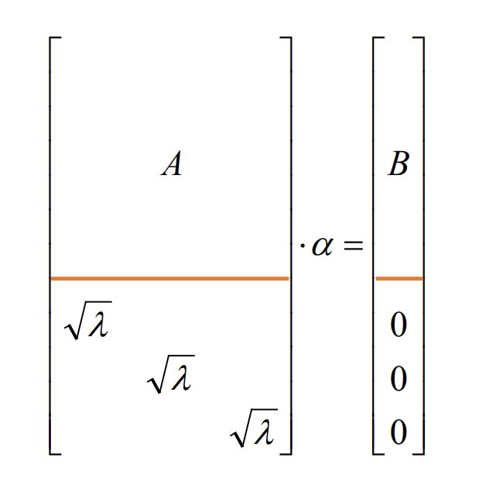
Methodology
Figure 1. Ax=B with regularization

Slide 6
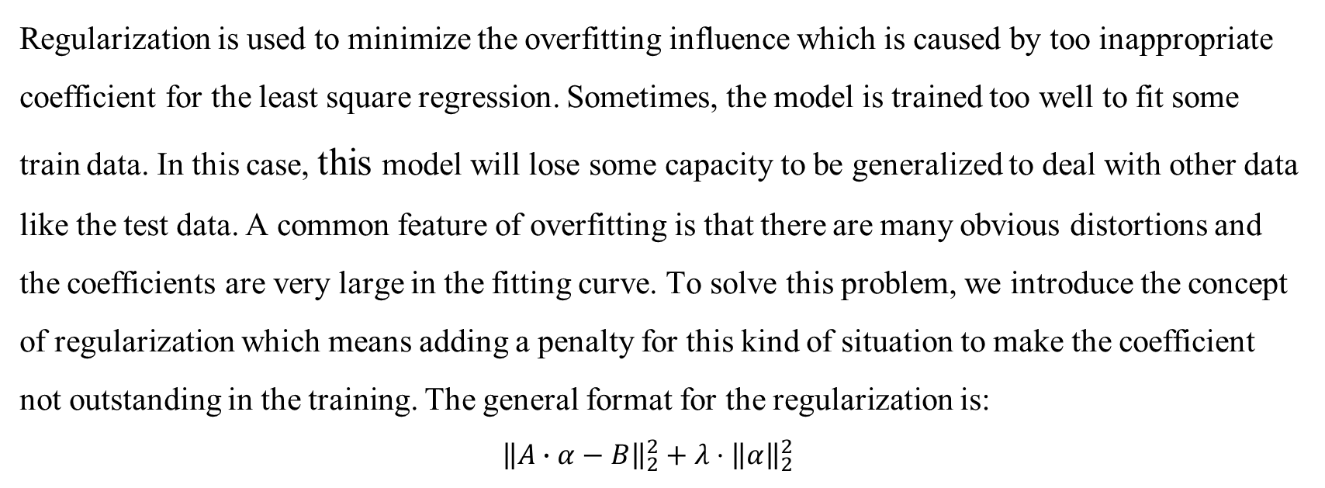
Methodology
Regularization is used to minimize the overfitting influence which is caused by too inappropriate coefficient for the least square regression. Sometimes, the model is trained too well to fit some train data. In this case, this model will lose some capacity to be generalized to deal with other data like the test data. A common feature of overfitting is that there are many obvious distortions and the coefficients are very large in the fitting curve. To solve this problem, we introduce the concept of regularization which means adding a penalty for this kind of situation to make the coefficient not outstanding in the training. The general format for the regularization is:
$${\left\|A∙α−B\right\|}_{2}^{2}+λ⋅{\left\|α\right\|}_{2}^{2}$$

Slide 7
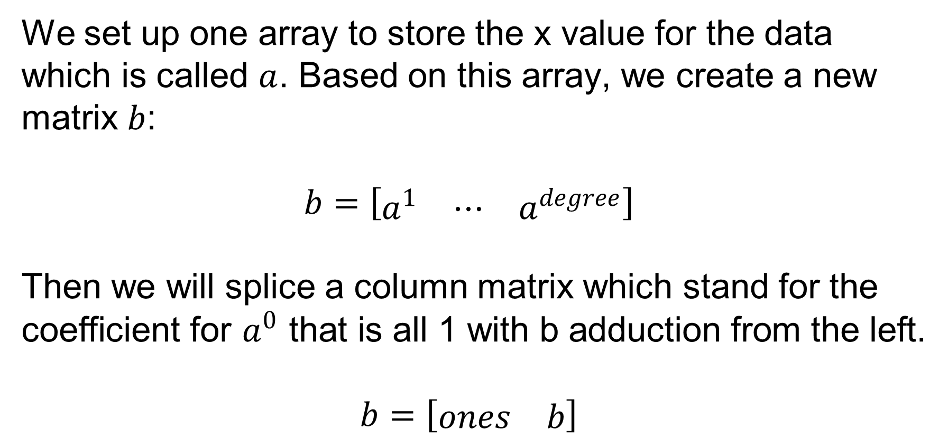
Methodology
We set up one array to store the x value for the data which is called $a$. Based on this array, we create a new matrix $b$:
$$b=\left[\begin{matrix}\begin{matrix}a^{1} & ⋯ & a^{degree}\end{matrix}\end{matrix}\right]$$
Then we will splice a column matrix which stand for the coefficient for $a^{0}$ that is all 1 with b adduction from the left.
$$b=\left[\begin{matrix}ones & b\end{matrix}\right]$$

Slide 8
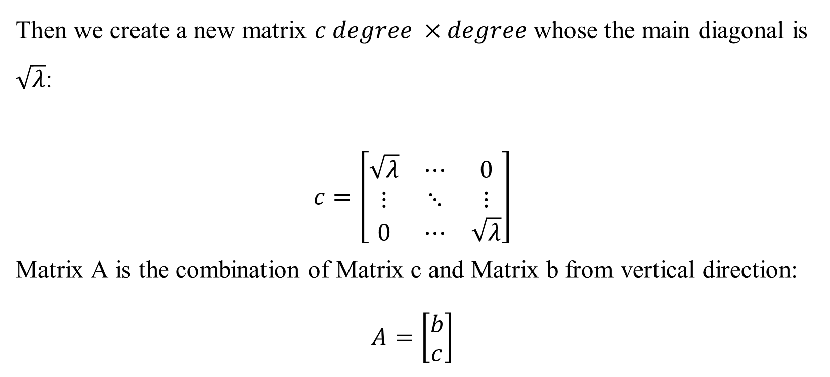
Methodology
Then we create a new matrix $c degree ×degree$ whose the main diagonal is $\sqrt{λ}$:
$$c=\left[\begin{matrix}\sqrt{λ} & ⋯ & 0 \\ ⋮ & ⋱ & ⋮ \\ 0 & ⋯ & \sqrt{λ}\end{matrix}\right]$$
Matrix A is the combination of Matrix c and Matrix b from vertical direction:
$$A=\left[\begin{matrix}b \\ c\end{matrix}\right]$$

Slide 9
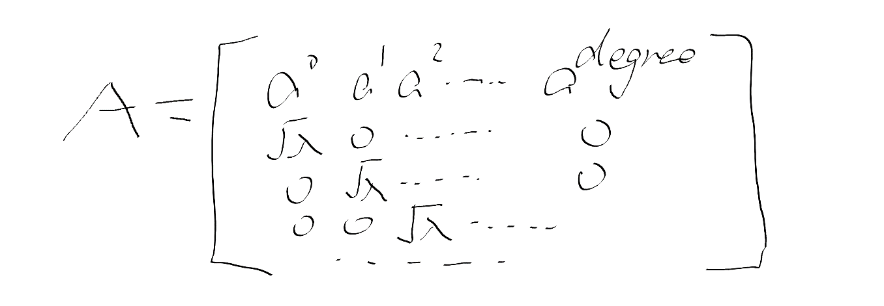
Methodology
Picture 1. Composition of A matrix

Slide 10
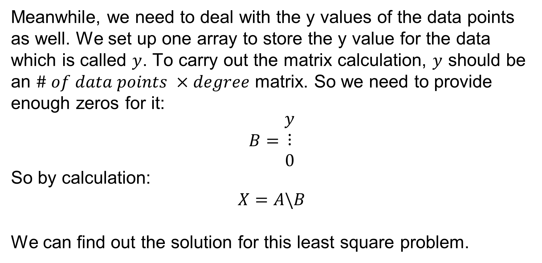
Methodology
Meanwhile, we need to deal with the y values of the data points as well. We set up one array to store the y value for the data which is called $y$. To carry out the matrix calculation, $y$ should be an $\# of data points ×degree$ matrix. So we need to provide enough zeros for it:
$$B=\begin{matrix}y \\ ⋮ \\ 0\end{matrix}$$
So by calculation:
$$X=A\backslash B$$
We can find out the solution for this least square problem.

Slide 11
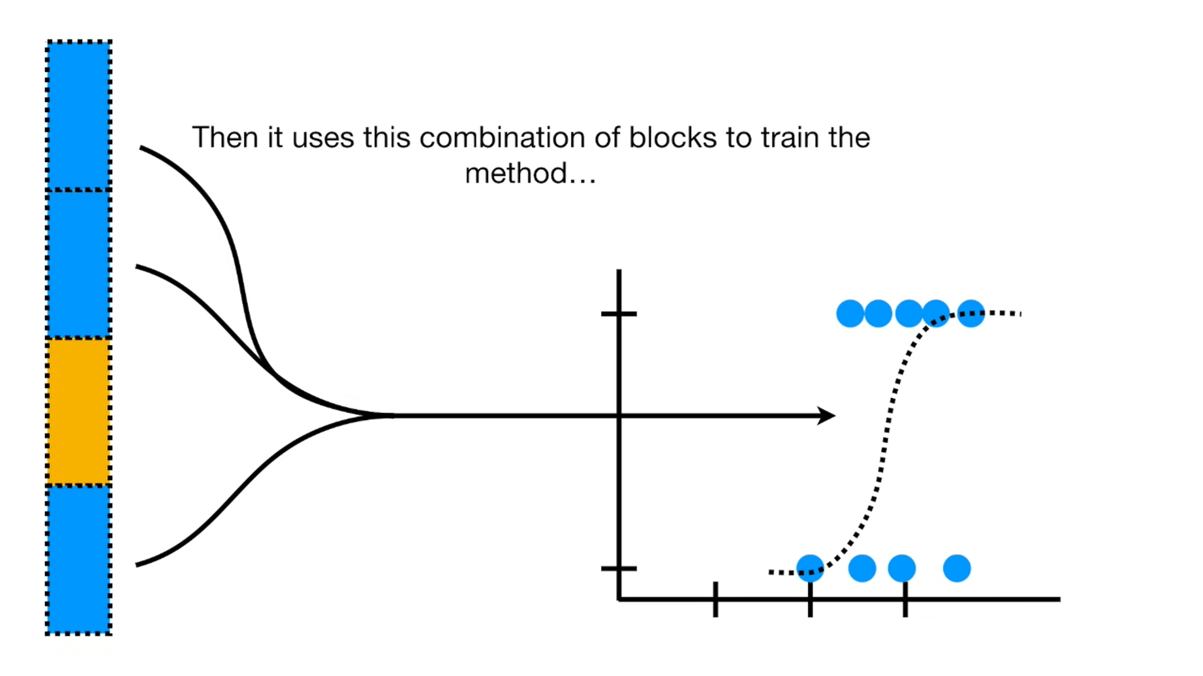
Methodology
Picture 2. Example of 4-fold cross validation

Slide 12
Result-Task1
Model | N=1 | N=2 | N=3 | N=4 | N=5 | N=6 | N=7 | N=8 | N=9
Training Error | 0.855951 | 0.853836 | 0.27023 | 0.243957 | 0.168454 | 0.153101 | 0.110869 | 0.074539 | 1.18E-20
Test Error | 0.156486 | 0.146281 | 0.148816 | 0.161313 | 0.25901 | 0.302324 | 0.398575 | 0.413903 | 4.979396
Table 1. Small Data Error without regularization

Slide 13
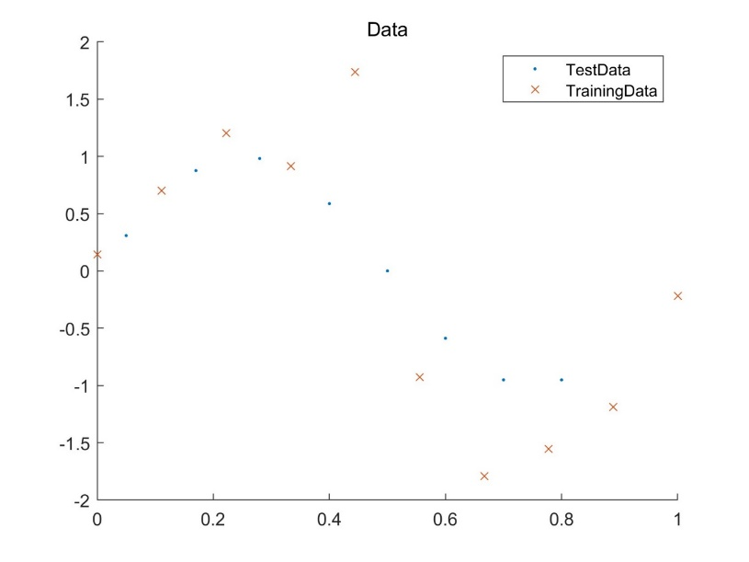
Result-Task1
Figure 2. Training Data and Test Data for Task1

Slide 14
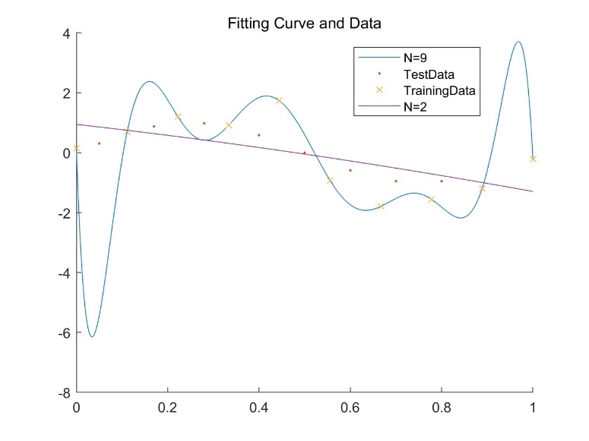
Result-Task1
Figure 3. Data and Fitting Curve with smallest error

Slide 15

Result-Task1
From a., we can see that when $n=2$, we have the smallest Test Error:
$$a_{0}=0.9464$$
$$a_{1}=−1.7276$$
$$a_{2}=−0.5127$$
When $n=9$, we have the smallest Training Error:
$$a_{0}=0.0000$$
$$a_{1}=−0.0004$$
$$a_{2}=0.0104$$
$$a_{3}=−0.0935$$
$$a_{4}=0.4348$$
$$a_{5}=−1.1689$$
$$a_{6}=1.8835$$
$$a_{7}=−1.7944$$
$$a_{8}=0.9318$$
$$a_{9}=−0.2032$$

Slide 16
Result-Task2
Model | N=1 | N=2 | N=3 | N=4 | N=5 | N=6 | N=7 | N=8 | N=9
Training Error | 0.386532 | 0.386018 | 0.215725 | 0.215499 | 0.209562 | 0.206802 | 0.205401 | 0.202191 | 0.20051
Test Error | 0.181946 | 0.178101 | 0.004612 | 0.004618 | 0.000477 | 0.002946 | 0.00507 | 0.00912 | 0.007493
Table 2. Large Data Error without regularization

Slide 17
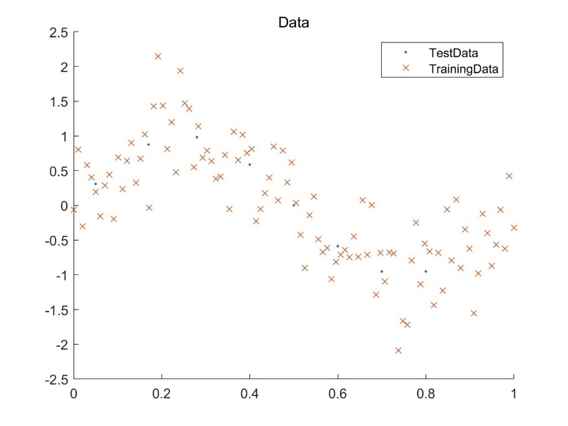
Result-Task2
Figure 4. Training Data and Test Data for Task2

Slide 18
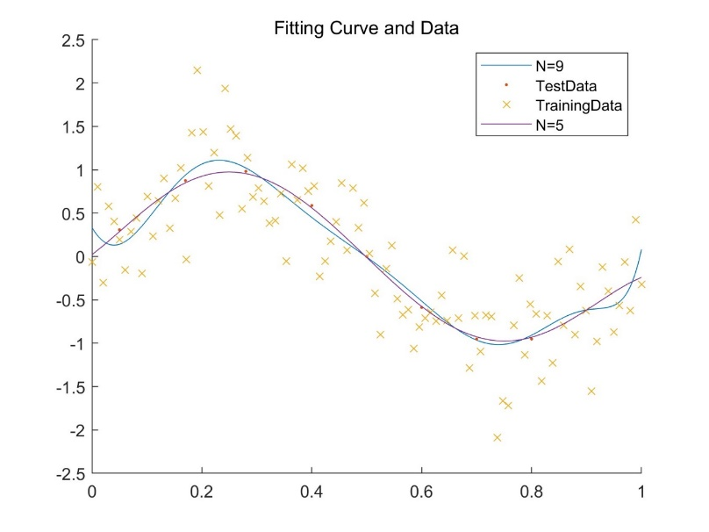
Result-Task2
Figure 5. Large Data and Fitting Curve with smallest error

Slide 19

Result-Task2
From a., we can see that when $n=5$, we have the smallest Test Error:
$$a_{0}=0.0212$$
$$a_{1}=4.8355$$
$$a_{2}=14.6874$$
$$a_{3}=−108.8702$$
$$a_{4}=150.4993$$
$$a_{5}=−61.4130$$
When $n=9$, we have the smallest Train Error:
$$a_{0}=0.0000$$
$$a_{1}=−0.0011$$
$$a_{2}=0.0142$$
$$a_{3}=0.0022$$
$$a_{4}=−0.4917$$
$$a_{5}=2.2966$$
$$a_{6}=−4.9279$$
$$a_{7}=5.6457$$
$$a_{8}=−3.3434$$
$$a_{9}=0.8053$$

Slide 20
Result-Task3
Model | 10^-6 | 10^-3 | 1 | 10^3 | 10^6
Training Error | 0.156036 | 0.229233 | 0.839931 | 1.370526 | 1.376684
Test Error | 0.280026 | 0.139054 | 0.192366 | 0.538351 | 0.541034
Table 3. Regularization Error

Slide 21
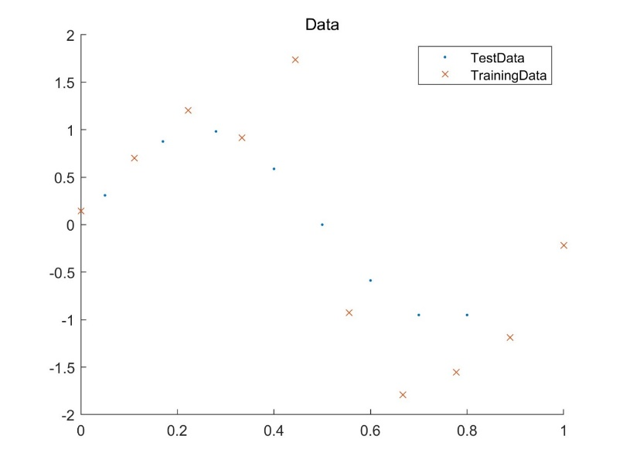
Result-Task3
Figure 6. Training Data and Test Data for Task3

Slide 22
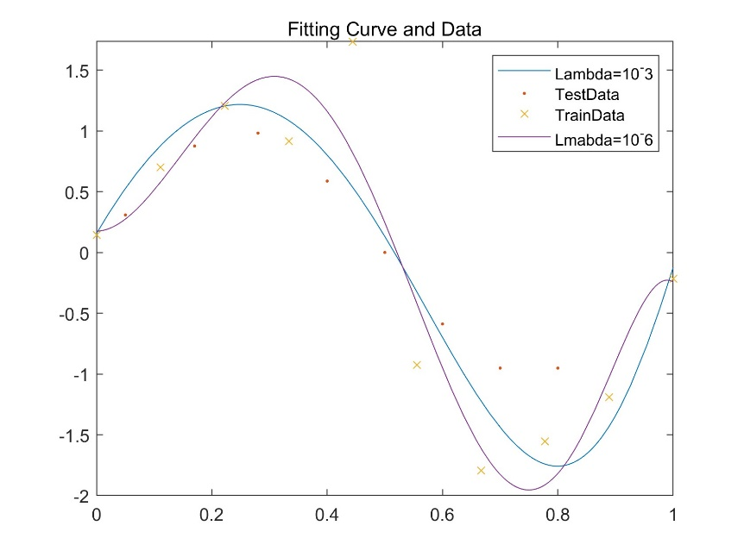
Result-Task3
Figure 7. Fitting Curve and Data

Slide 23
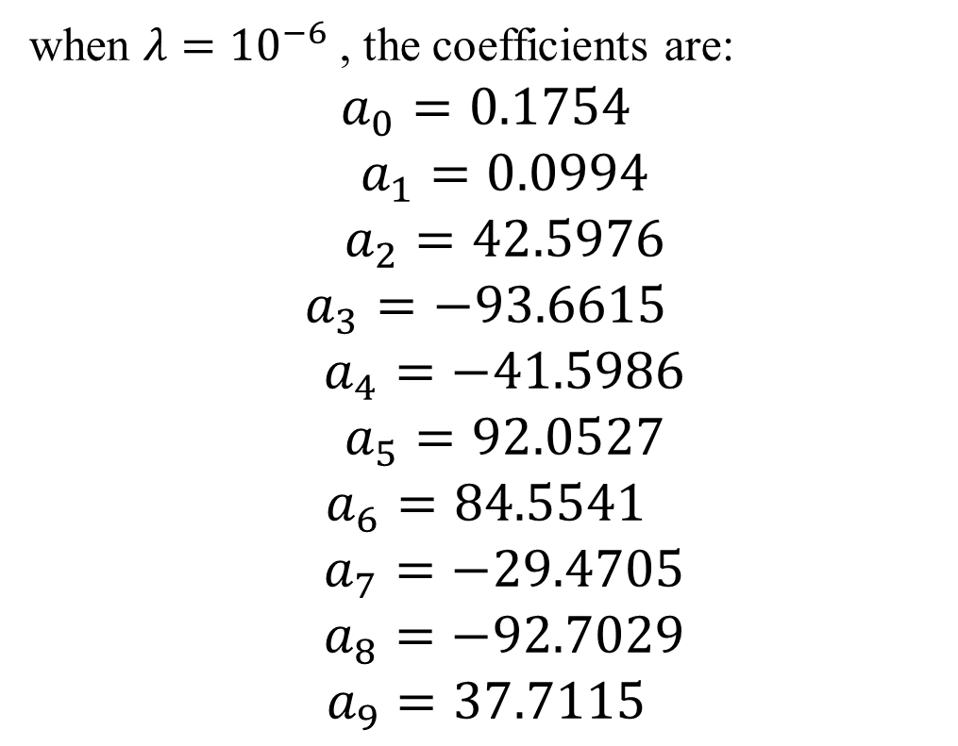
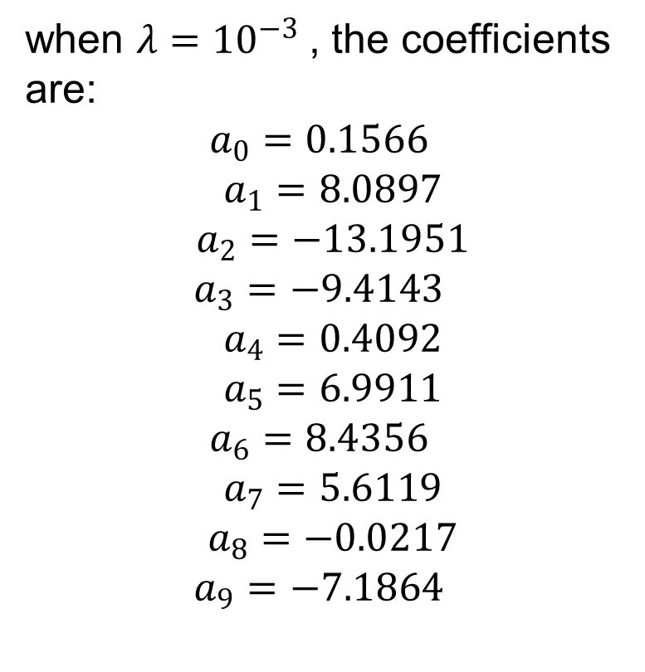
Result-Task3
when $λ={10}^{−3}$, the coefficients are: $$a_{0}=0.1566$$
$$a_{1}=8.0897$$
$$a_{2}=−13.1951$$
$$a_{3}=−9.4143$$
$$a_{4}=0.4092$$
$$a_{5}=6.9911$$
$$a_{6}=8.4356$$
$$a_{7}=5.6119$$
$$a_{8}=−0.0217$$
$$a_{9}=−7.1864$$
when $λ={10}^{−6}$, the coefficients are: $$a_{0}=0.1754$$
$$a_{1}=0.0994$$
$$a_{2}=42.5976$$
$$a_{3}=−93.6615$$
$$a_{4}=−41.5986$$
$$a_{5}=92.0527$$
$$a_{6}=84.5541$$
$$a_{7}=−29.4705$$
$$a_{8}=−92.7029$$
$$a_{9}=37.7115$$

Slide 24
Result-Task4
Weight | 10^-6 | 10^-3 | 10^-0 | 10^3 | 10^6
average validation error | 0.061266 | 0.021855 | 0.064627 | 0.179386 | 0.136178
Table 4. Cross Validation

Slide 25

Result-Task4
$$Test Error=0.27119115012813369557673835053065$$
Coefficient:
$$a_{0}=−0.0185$$
$$a_{1}=7.8914$$
$$a_{2}=−15.8554$$
$$a_{3}=−4.7887$$
$$a_{4}=5.6510$$
$$a_{5}=7.6883$$
$$a_{6}=4.8984$$
$$a_{7}=0.8601$$
$$a_{8}=−2.4331$$
$$a_{9}=−4.1180$$
Best regularization weight:
$$λ={10}^{−3}$$

Slide 26
Discussion
Training errors decrease with the increase of degree
Model | N=1 | N=2 | N=3 | N=4 | N=5 | N=6 | N=7 | N=8 | N=9
Training Error | 0.855951 | 0.853836 | 0.27023 | 0.243957 | 0.168454 | 0.153101 | 0.110869 | 0.074539 | 1.18E-20
Small Data
Model | N=1 | N=2 | N=3 | N=4 | N=5 | N=6 | N=7 | N=8 | N=9
Training Error | 0.386532 | 0.386018 | 0.215725 | 0.215499 | 0.209562 | 0.206802 | 0.205401 | 0.202191 | 0.20051
Large Data

Slide 27
Discussion
Test errors do not have this tendency
Model | N=1 | N=2 | N=3 | N=4 | N=5 | N=6 | N=7 | N=8 | N=9
Test Error | 0.156486 | 0.146281 | 0.148816 | 0.161313 | 0.25901 | 0.302324 | 0.398575 | 0.413903 | 4.979396
Small Data
Model | N=1 | N=2 | N=3 | N=4 | N=5 | N=6 | N=7 | N=8 | N=9
Test Error | 0.181946 | 0.178101 | 0.004612 | 0.004618 | 0.000477 | 0.002946 | 0.00507 | 0.00912 | 0.007493
Large Data

Slide 28
Discussion
Training errors decrease with the increase of dataset
Model | N=1 | N=2 | N=3 | N=4 | N=5 | N=6 | N=7 | N=8 | N=9
Training Error | 0.855951 | 0.853836 | 0.27023 | 0.243957 | 0.168454 | 0.153101 | 0.110869 | 0.074539 | 1.18E-20
Small Data
Model | N=1 | N=2 | N=3 | N=4 | N=5 | N=6 | N=7 | N=8 | N=9
Training Error | 0.386532 | 0.386018 | 0.215725 | 0.215499 | 0.209562 | 0.206802 | 0.205401 | 0.202191 | 0.20051
Large Data

Slide 29
Discussion
Test errors do have this tendency
Model | N=1 | N=2 | N=3 | N=4 | N=5 | N=6 | N=7 | N=8 | N=9
Test Error | 0.156486 | 0.146281 | 0.148816 | 0.161313 | 0.25901 | 0.302324 | 0.398575 | 0.413903 | 4.979396
Small Data
Model | N=1 | N=2 | N=3 | N=4 | N=5 | N=6 | N=7 | N=8 | N=9
Test Error | 0.181946 | 0.178101 | 0.004612 | 0.004618 | 0.000477 | 0.002946 | 0.00507 | 0.00912 | 0.007493
Large Data

Slide 30
Discussion
Value of N=9 is weird
Model | N=1 | N=2 | N=3 | N=4 | N=5 | N=6 | N=7 | N=8 | N=9
Training Error | 0.855951 | 0.853836 | 0.27023 | 0.243957 | 0.168454 | 0.153101 | 0.110869 | 0.074539 | 1.18E-20
Test Error | 0.156486 | 0.146281 | 0.148816 | 0.161313 | 0.25901 | 0.302324 | 0.398575 | 0.413903 | 4.979396
Table 1. Small Data Error without regularization

Slide 31
Thanks

